Slide 1
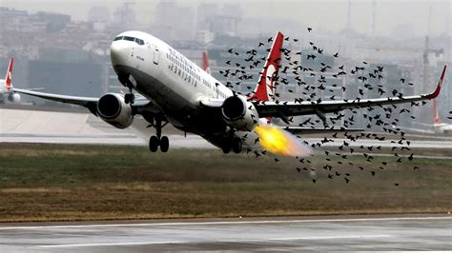
Data Visualization of Bird Strikes between 2000-2011
Vinay Borkar

Slide 2
Project Detail
Project Title | Data Visualization of Bird Strikes between 2000-2011
Technology | Business Intelligence
Domain | Transportation and Communication
Project Difficulty Level | Advanced
Programming Language Used | Python Programming
Tools used | Jupyter Notebook, MS-Excel, MS-PowerBI

Slide 3
Introduction
Transport and communication are critical domains in the field of analytics.
Environmental impacts and safety are major concerns in transport scenarios and urban areas.
Increasing vehicles and people highlight the need for new solutions.

Slide 4

Problem Statement
The goal of this project is to analyse the bird strike incidents happened between 2000-2011. To achieve the goal, we used a data set that is collected by FAA during 2000-2011. The objective of the project is to perform data visualization techniques to understand insights of the data. This project aims apply various Business Intelligence tools such as Tableau or Power BI to get a visual understanding of the data.

Slide 5
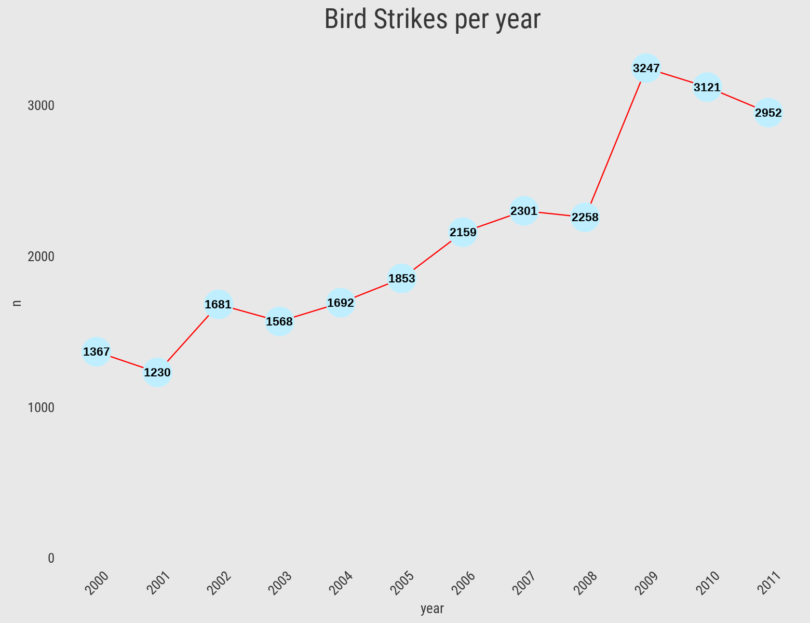
Insights
Total Number of Bird Strikes Incidents per Year
We can see that Bird Strikes Incidents have an upward trend
2009 has the highest number of incidents.

Slide 6
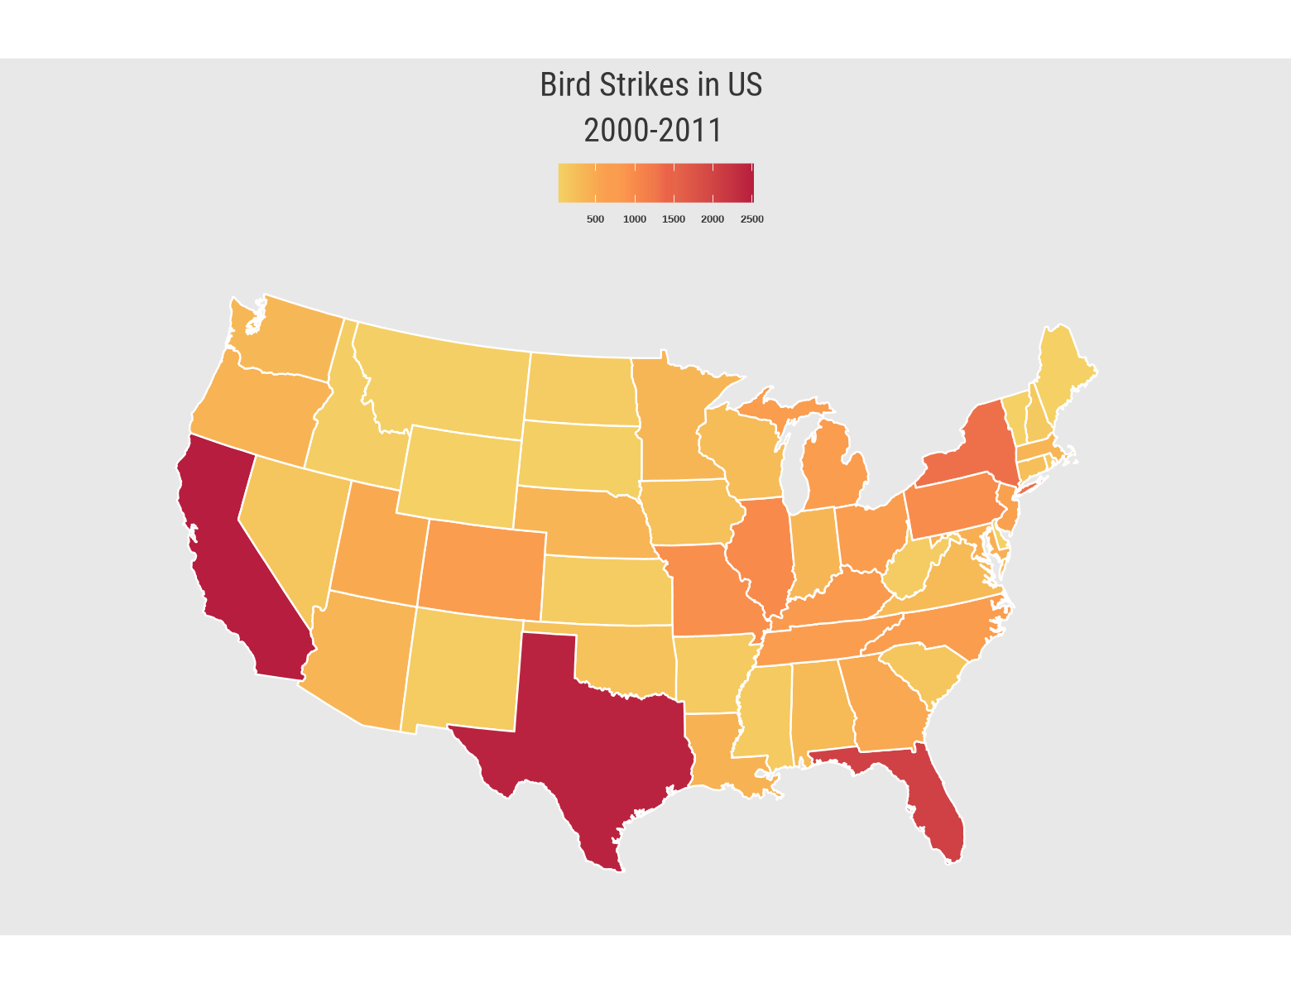
Bird Strikes Incidents in US
California, Texas and Florida has the highest number of bird strike incidents.

Slide 7
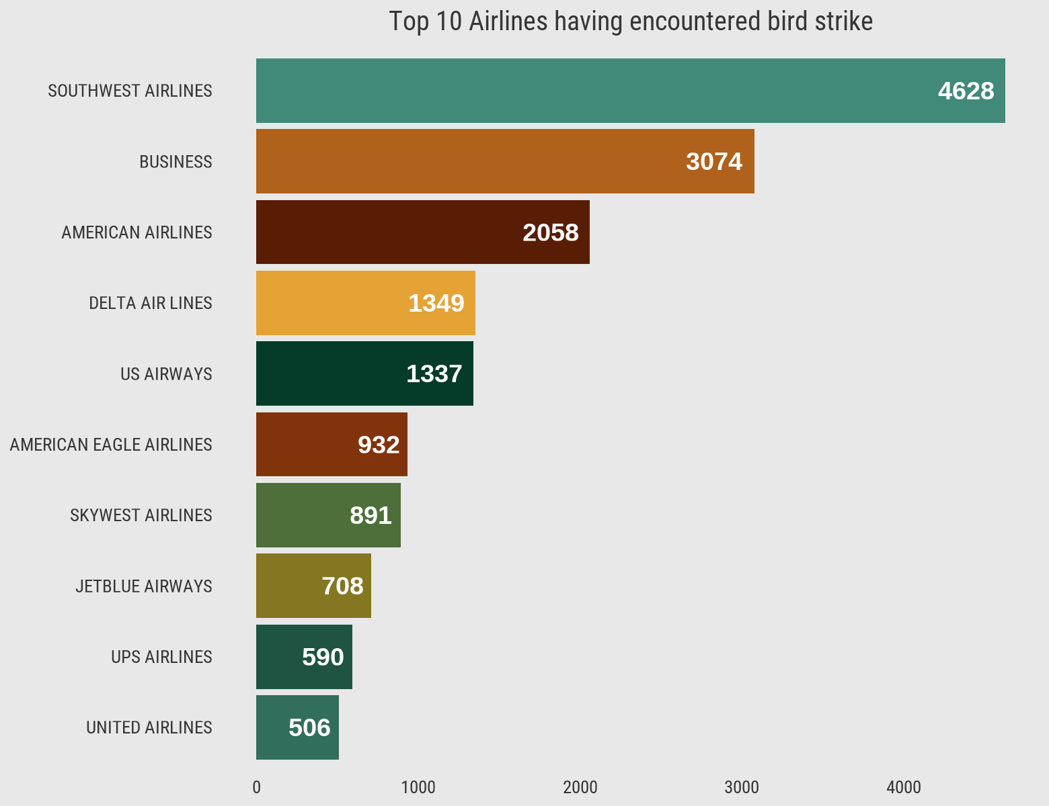
Top 10 Airlines having encountered most number of bird strikes
Southwest airlines has encountered most number of bird strike followed by business and American airlines

Slide 8
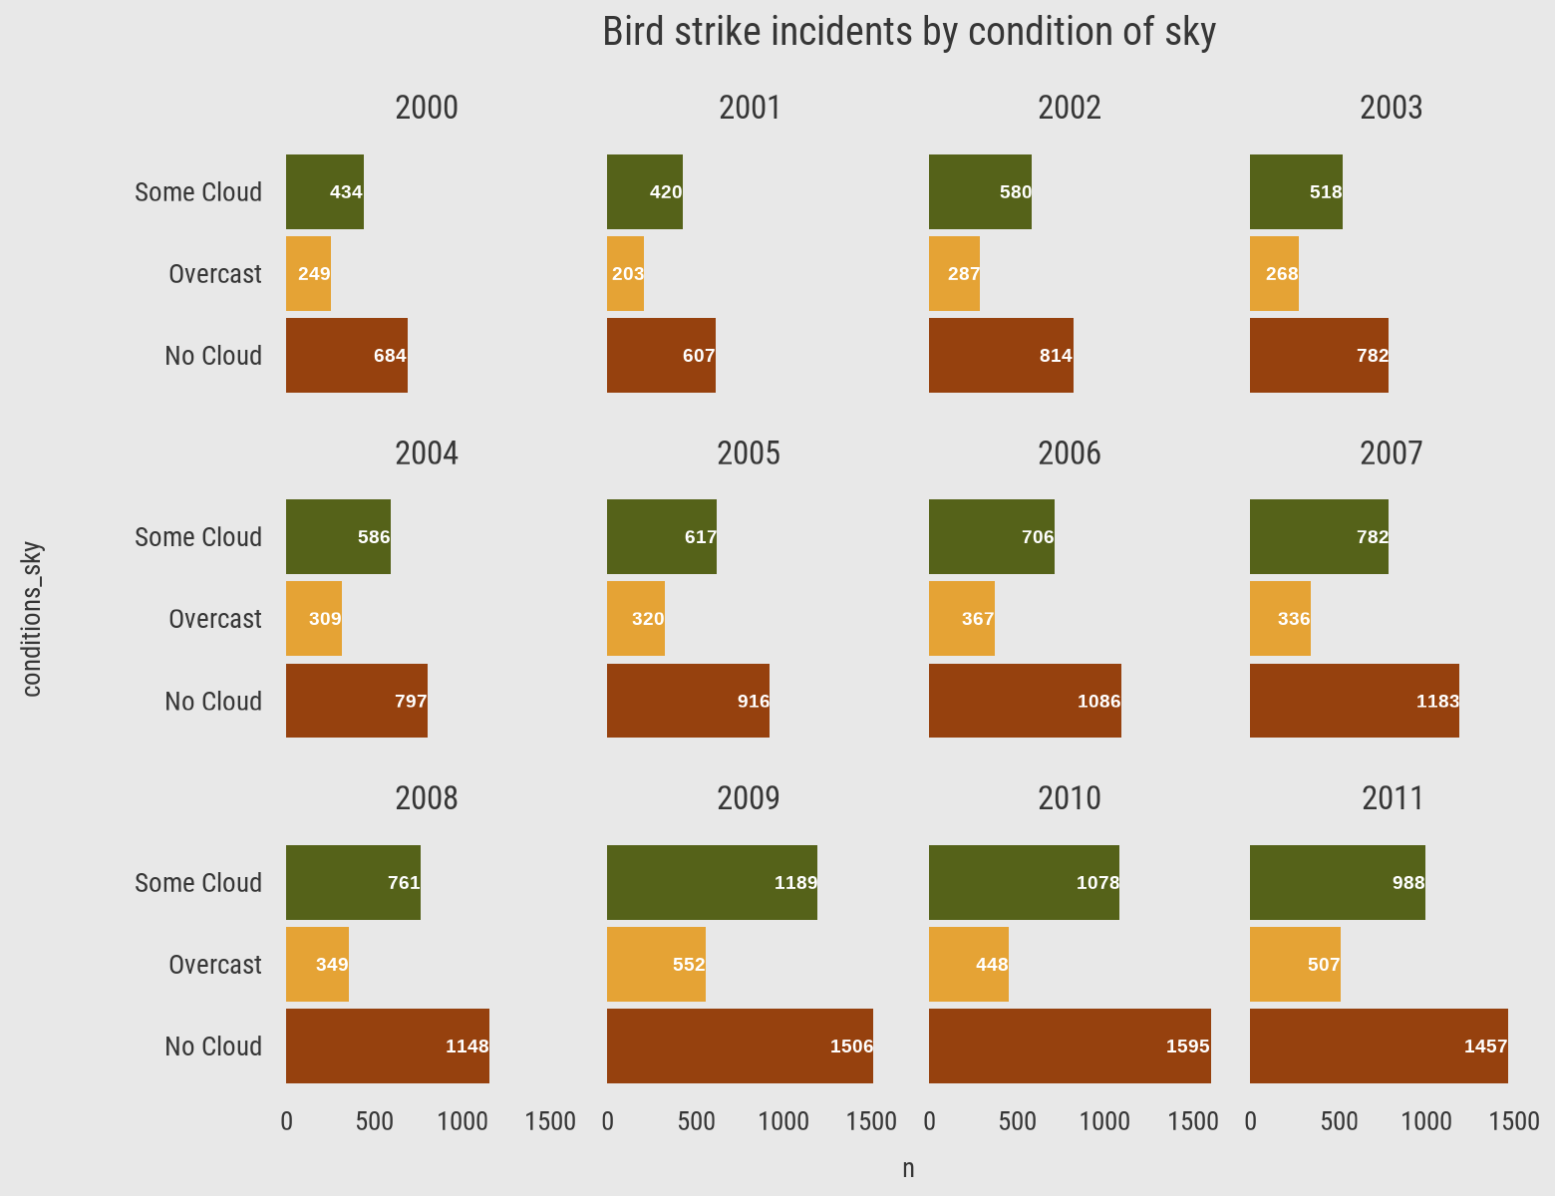
When do most bird strike incidents occur?
Most of the incidents have happened when there was no cloud in each year

Slide 9
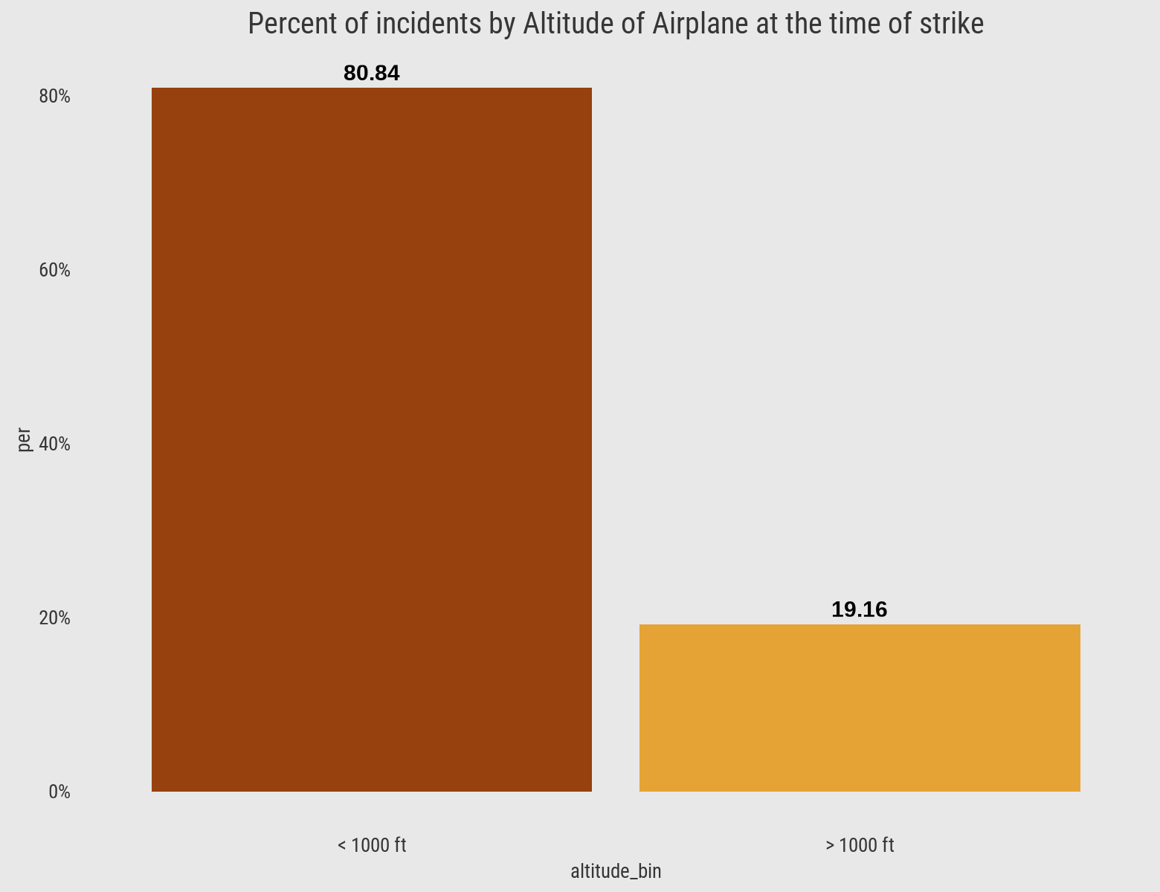
Altitude of Airplane at the time of bird strike
80.84% of bird strike incidents have happened when the altitude of airplane was <1000 ft and 19.16% have happened when altitude was >1000 ft.

Slide 10
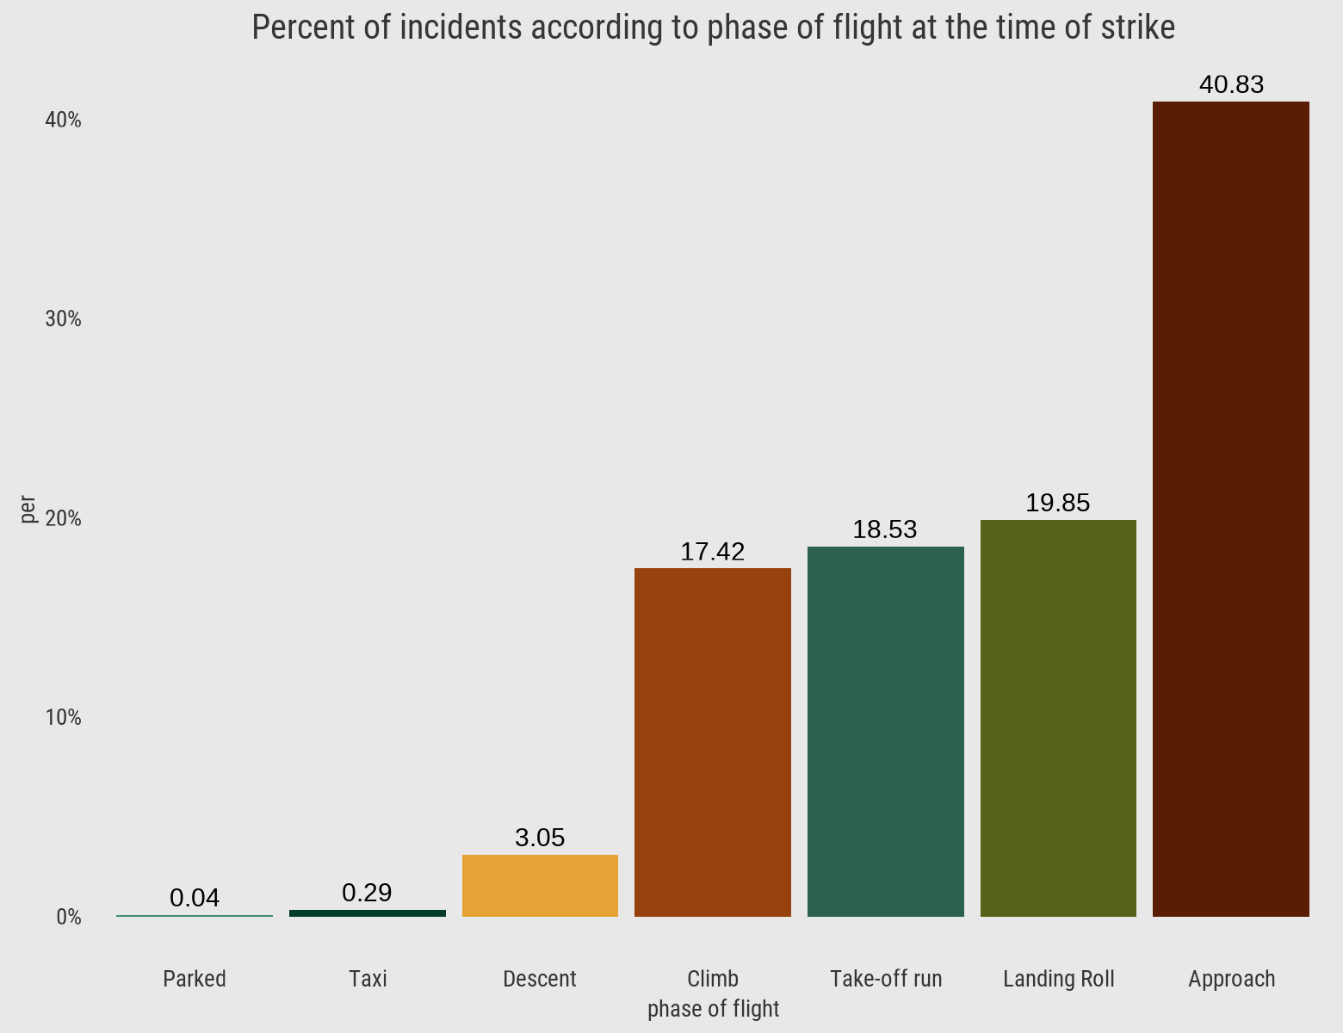
Phase of Flight at the time of strike
Highest number of strikes during Approach followed by Landing Roll and Take-off run

Slide 11
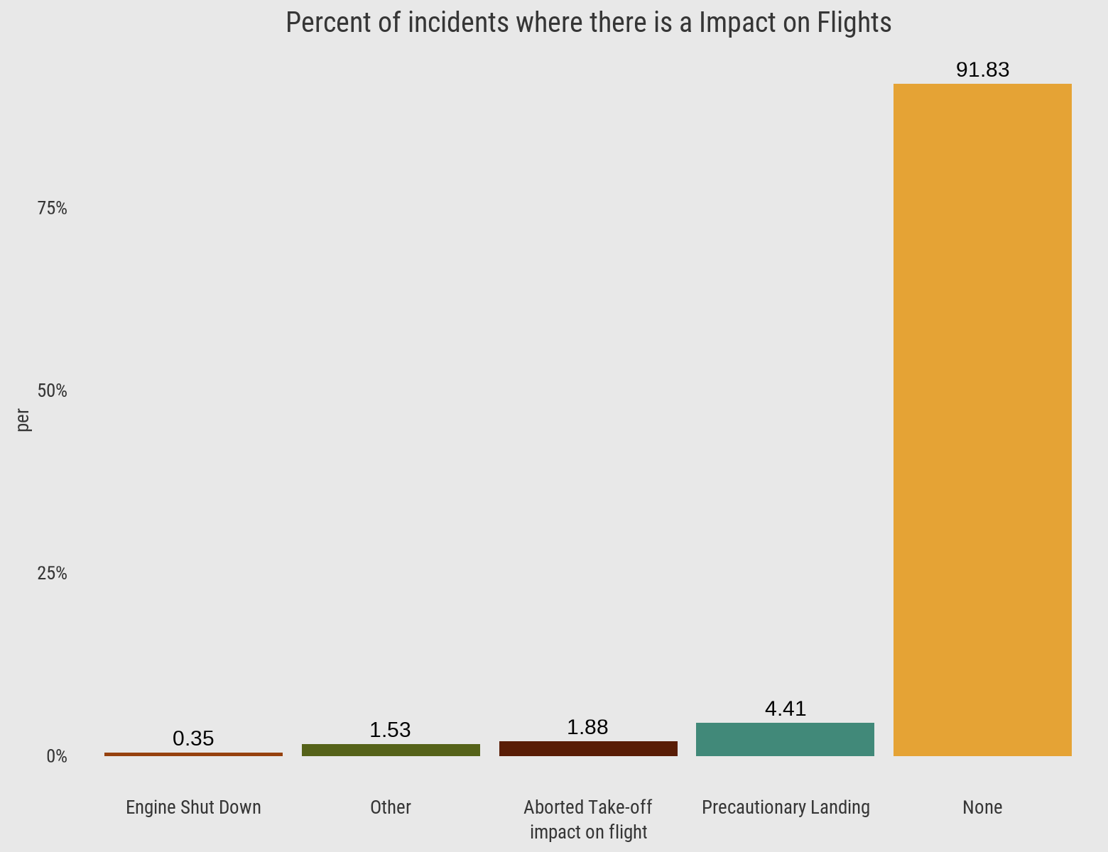
Impact on Flights
91.83% incidents where there was no impact on flights

Slide 12
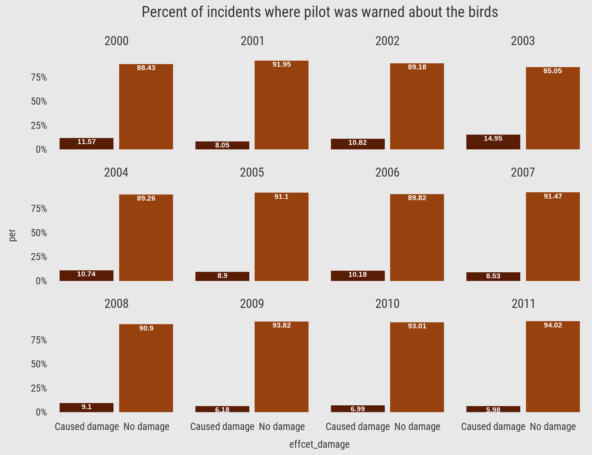
Does prior warning reduces the effect of damage?
Prior warning to the pilot does reduces the effect damage to the airplane. In 80% of the incidents there was no damage to the airplane.

Slide 13
Conclusion
Over the span of 11 years, there were approximately 25.43 thousand bird strike incidents.
During this period, more than 2400 aircraft were damaged due to bird strikes, resulting in repair costs amounting to 136 million dollars.
Out of the 25,429 flights involved in bird strike incidents, 22,975 flights suffered no damage, while 2,454 flights experienced varying degrees of damage.
The number of bird strike incidents has shown a consistent yearly increase from 2000 to 2011, with the highest number of strikes occurring in 2010 and the lowest in 2004.
Airlines such as Business, Southwest Airlines, American Airlines, Delta Air Airlines, and US Airlines have had a higher frequency of bird strike incidents compared to other airlines.
California has witnessed the highest number of bird strike incidents among all states in the USA, followed by Texas.
States like Montana have reported a relatively lower number of bird strike incidents compared to others.

